Slide 1
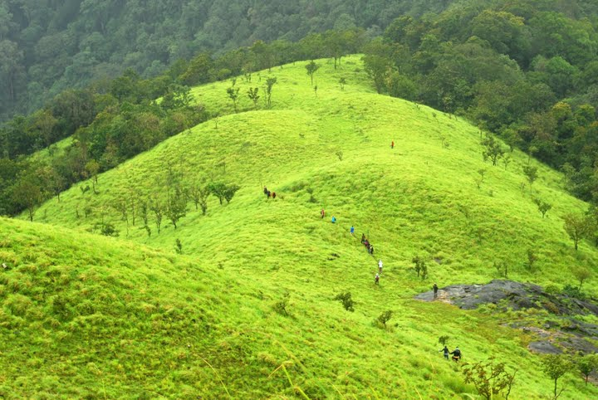
Environmental Resources, Governance, and Conflicts
To whom should resources belong? Private, public, common?
How should resources be governed or managed? Rules and Regulations, customs and traditions
Which form of ownership or control is better for preventing resource depletion?
Why does resource degradation occur?
Should resources be shared equitably, or, be owned / used only by those who can afford to pay?
Should we pay for natural resources? How much should we pay

Slide 2
Commons or CPR

Slide 3
Understanding Common or CPR
“the cultural and natural resources accessible to all members of a society, such as air, water, and a habitable earth”.. (in modern economic theory)
Common Pool Resources
A common-pool resource (CPR) is defined as any resource in which exclusion is difficult and consumption of resource units is rival. Examples of CPRs include groundwater basins, fisheries, forests, grazing ranges, and irrigation systems in which property rights--or the ability to uphold such rights--do not allow for privatization." (http://dlc.dlib.indiana.edu/archive/00003301

Slide 4

Whenever a group of people depend on a resource that everybody uses but nobody owns, and where one person's use effects another person's ability to use the resource, either the population fails to provide the resource, over consumes and/or fails to replenish it, or they construct an institution for undertaking and managing collective action→ CPR.

Slide 5
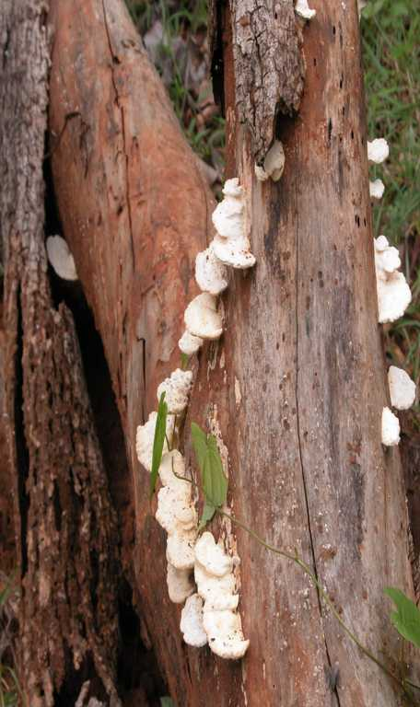
Commons in India
Significance and Issues

Slide 6
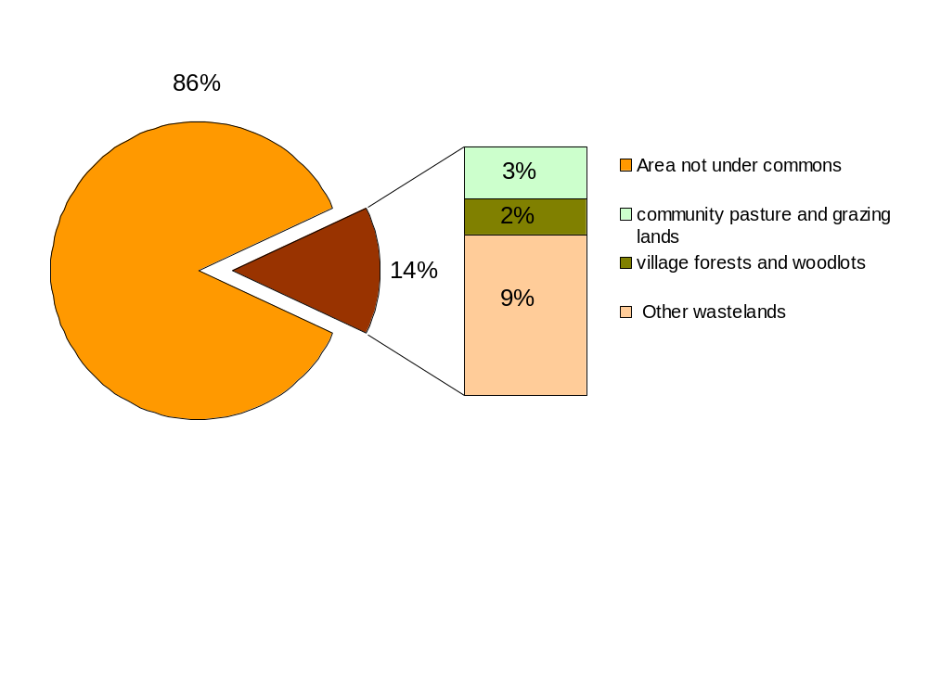
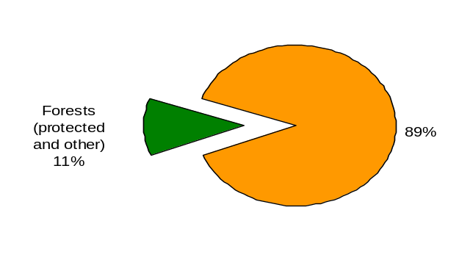
Commons in India*
NSSO, 1999
Use of de facto commons is a better indicator of dependence on the commons.
11%
Chopra and Gulati(2001)
Notes:
→ Need to add figures of area of Reserve forest under JFM

Slide 7
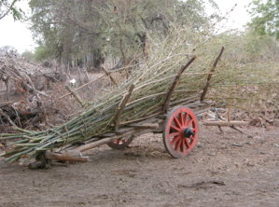
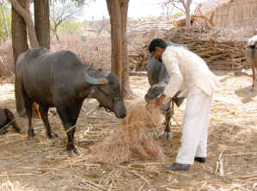
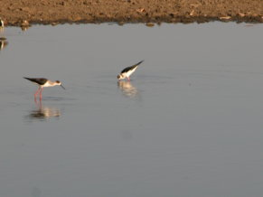
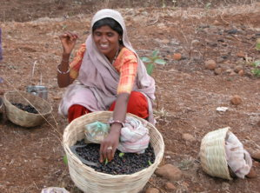
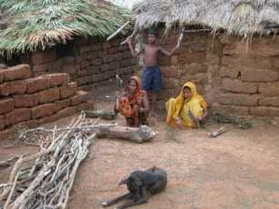
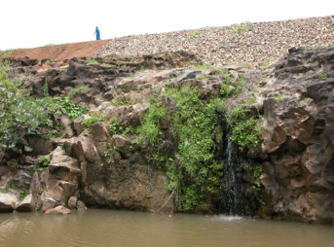
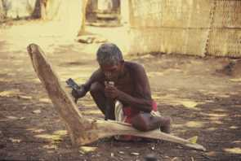
Commons contribute an estimated US$ 5 billion to the incomes of poor Indian households. Beck and Nesmith(2001)

Slide 8
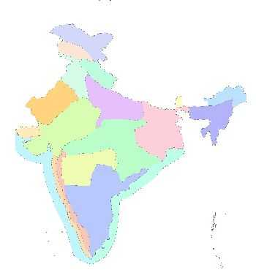
Agro-climatic Variations
8%
69 %
71%
53%
Percentage of households collecting CPR products ranges from 73 in the Eastern Plateau to 13 in the Western dry region forming a national average of 48%.
31%
51 %
13%
29%
30 %
39 %
73%
64%
4%
62%
0%
0%
47 %
18 %
31 %
20 %
65%
51 %
18 %
72%
17 %
65 %
% HHs collecting CPRs products
18 %
10 %
% share of product in CPR products
Fodder
Fuelwood
NTFP
Menon and Vadivelu, 2006)

Slide 9
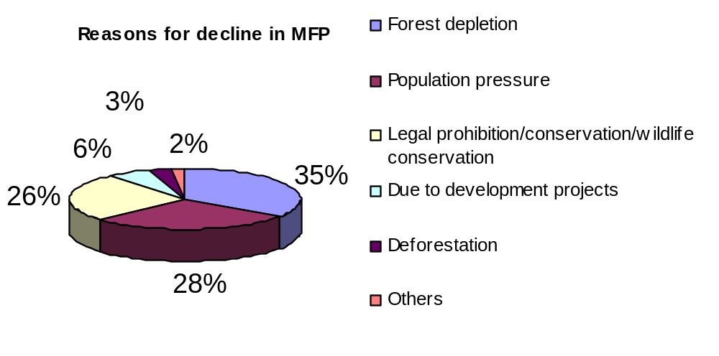
Reasons for Decline of Minor Forest Produce (MFP)
Political Economy of Hunger in Adivasi Areas, Cntr for Envt & Food Security ‘05
MFP provides substantial sustenance to tribals living on the fringe of standing forests… In some cases they are the main source of cash income through which they can meet other non-subsistence needs like health and education.

Slide 10
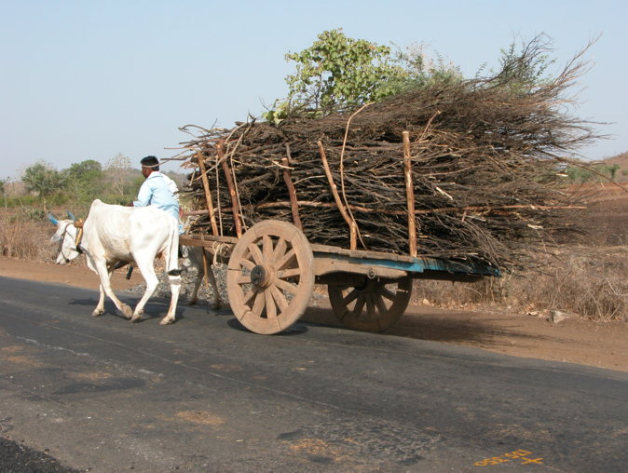
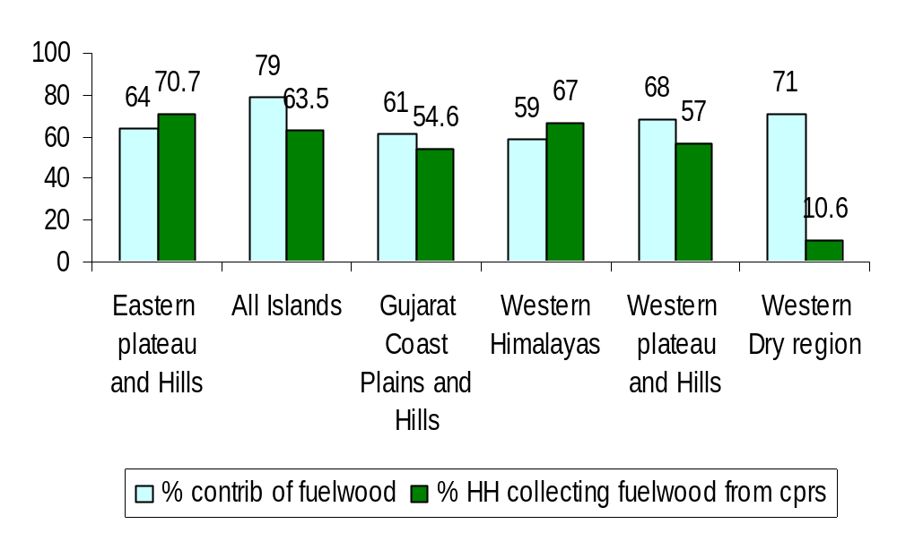
Fuelwood Provisions
Fuelwood remains rural India’s predominant source of domestic energy
(NSSO, 1999)
Notes:
Add picture on left

Slide 11
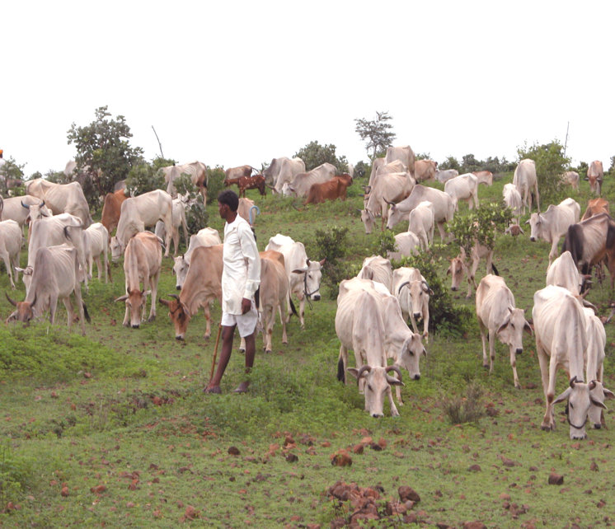
Supporting Animal Husbandry
75% of India’s farmers are marginal, and in the semi-arid conditions, follow a mixed farming system where agriculture is supplemented by animal husbandry.
25% of fodder needs across the country are met from the commons the percentage of households grazing livestock on CPRs at a high of 55 in the Western Himalayas

Slide 12
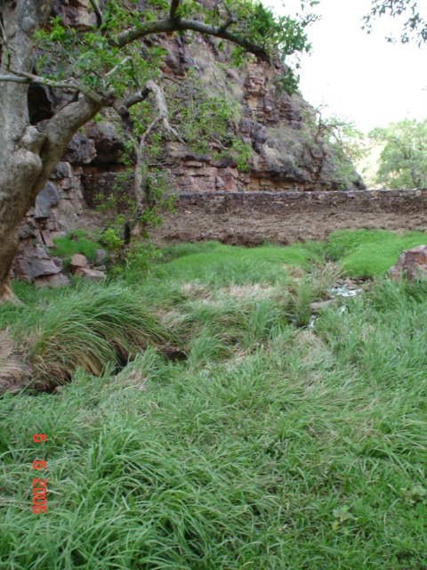
Sustaining Ecosystems

Slide 13
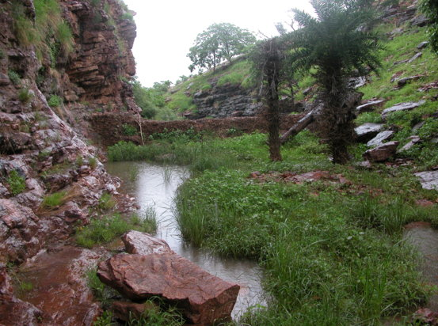
Commons are a vital link in hydrological processes impacting localized precipitation, runoff, soil erosion
Discharge from forested lands is less but more sustained than from exploited watersheds (James, 2000, Kumar, 1998)
Reduction in runoff as vegetation progressively increases. ( Sharda, 1982)

Slide 14
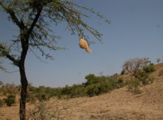
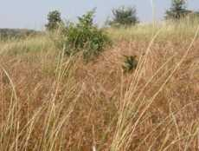
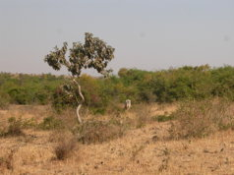
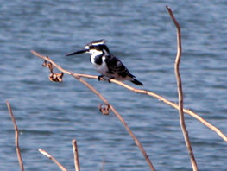
The resilience of ecosystems or resistance to factors of degradation is linked to biodiversity
Biodiversity contributes to functioning of an entire ecosystems and their
biogeochemical cycles.

Slide 15
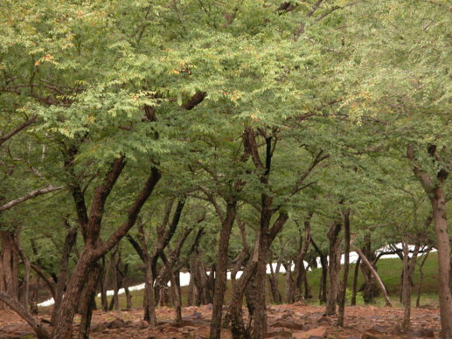
Commons act as ‘sinks’ absorbing harmful greenhouse gases that contributing to global warming
The National Forest Commission estimates the annual value of carbon stored per Ha. of India’s forests at between Rs. 20000 - Rs.1.2 lakhs.

Slide 16
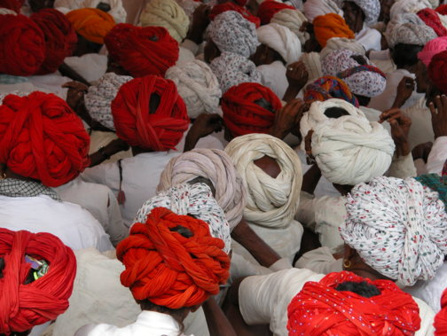
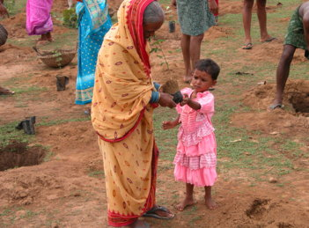
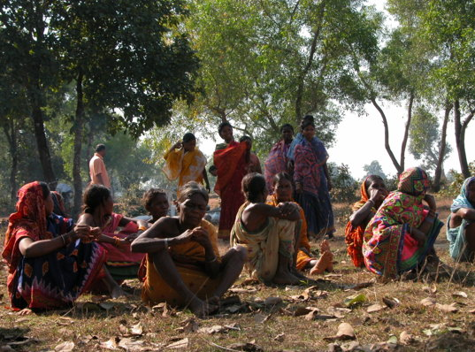
Commons and Community
Commons foster collective action and provide social support in times of distress.

Slide 17
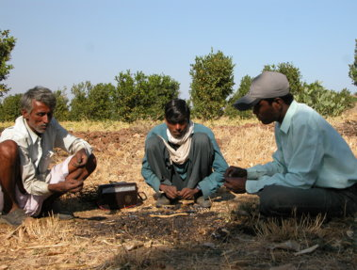
for the Rich and the Poor
14-23% of household income was met from CPRs for poor households, compared with only 1-3 per cent for the non-poor.
but
While the poor benefit more in relative terms, the rich benefit more in absolute terms.

Slide 18
Tragedy of the commons

Slide 19
Government, private, or common for efficient and sustainable resource management?
Common Pool Resources: Water, irrigation systems, Pasture / grazing land, forests, fisheries, oil fields, minerals, information, culture, ideas
Gareth Hardin: “Tragedy of the Commons”?
Free rider – overuse and exploitation?

Slide 20
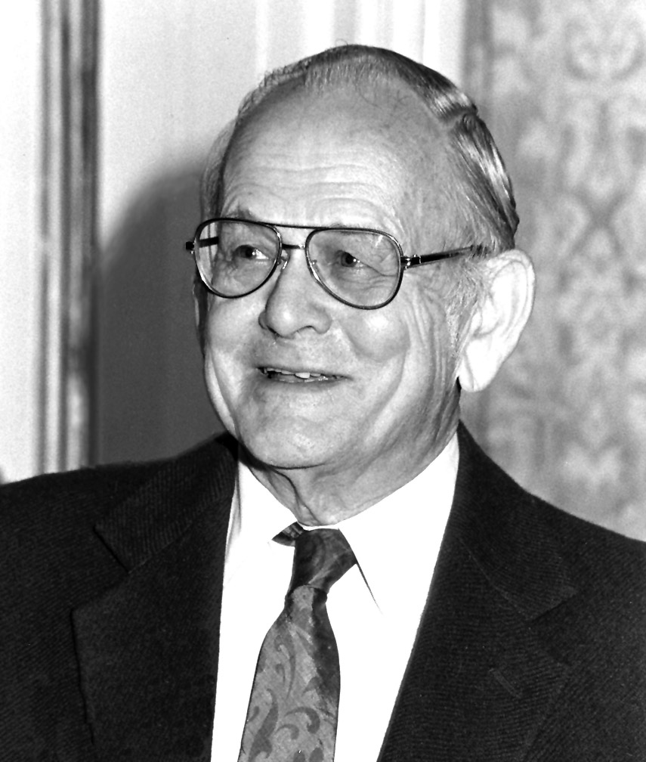
Tragedy of the commons
Garrett Hardin (1968)
Free rider – overuse and exploitation
describes how shared environmental resources are overused and eventually depleted

Slide 21
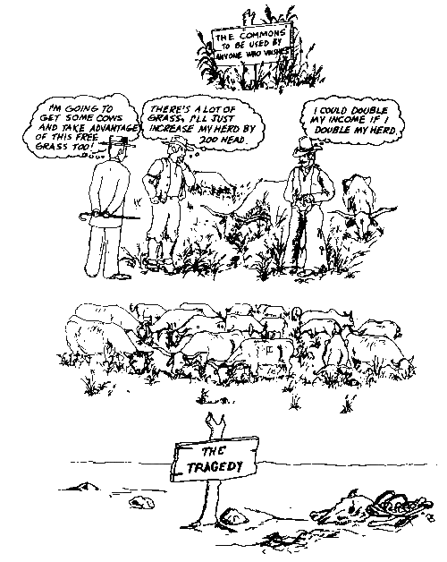
COMMONS: Tragedy or Mutual Benefit?
Understanding the commons: http://www.youtube.com/watch?v=otmrkhEFSZM

Slide 22
Real life Examples of Tragedy of Commons
Grand Banks fisheries
Gulf of Mexico dead zone
Traffic congestion
Groundwater in Los Angeles
Unregulated logging

Slide 23

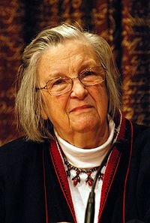
Alternate & Positive view of commons
Sustainable Governance of Common-Pool Resources
Elinor Ostrom

Slide 24
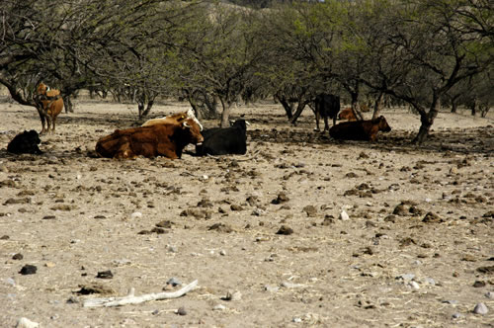
Environment, Governance, and the state
How do humans interact with ecosystems to maintain long-term sustainable resource yields?
What form of ownership and governance is best for sustainability? For preventing resource degradation or depletion? For ensuring equitable access?
      Regulation
      Ownership
Experiments in Resource Governance to promote equitable access and environmental sustainability
Natural Resource Management in Rural India: How Anna Hazare greened Ralegan: http://www.youtube.com/watch?v=aBfjsdICGT0
Village Republic

Slide 25
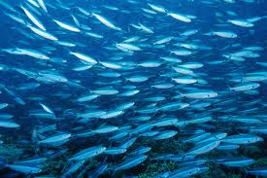
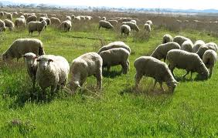
Alternate and positive view of commons: Elinor Ostrom on managing common pool resources: http://www.youtube.com/watch?v=D1xwV2UDPAg
How do humans interact with ecosystems to maintain long-term sustainable resource yields?
Multiplicity of governance and ownership arrangements
Elinor Ostrom: Governance of the Commons
How societies develop diverse institutional arrangements for managing natural resources and avoiding ecosystem collapse and prevent resource exhaustion

Slide 26
Elinor Ostrom: Governance of the Commons (contd.)
  Multifaceted nature of human–ecosystem interaction
  Diverse social-ecological system problems
  No singular or unique "panacea" for these problems
“Design Principles" for stable common pool resource management
Improve efficiency, prevent resource exhaustion, and avoid ecosystem collapse
Define boundaries clearly (to exclude external un-entitled parties)
Adapt rules regarding appropriation & provision of common resources to local conditions
Collective-choice arrangements: allow resource appropriators to participate in decision-making process
Effective monitoring (by monitors part of or accountable to appropriators)
Graduated sanctions for resource appropriators who violate community rules
Mechanisms of conflict resolution that are cheap and easy of access
Self-determination of community recognized by higher-level authorities
For larger common-pool resources: organize through multiple layers of nested enterprises - small local CPRs at base level

Slide 27
Application of those principles on Indian case
Experiments in Resource Governance to promote equitable access and environmental sustainability in India
Through CBNRM (Community Based Natural Resource Management)

Slide 28
Ralegaon Siddhi in the Deccan Plateau : example of Ideal Village based on CBNRM Principle

